Slide 1

https://www.uni-goettingen.de/en/48115.html
UNPLAB-QuGen_Ch-8[Decomp-GenV I]
Decompose genetic variance based on α₁, α₂, δ₁₁, δ₁₂, δ₂₂; et cetera
1

Slide 2
Sequential Number: #42
UNPLAB-QuGen_Ch-8[Decomp-GenV I]
Unless I explicitly state otherwise, images and cartoons are created using ChatGPT.
You may use this material free of charge under the terms of the CC BY license. This requires that you provide appropriate attribution to the author:
W. Link, University of Goettingen, Germany.
In a few cases, individual images, photographs, or similar material may be subject to a more restrictive Creative Commons license. Where this applies, it is explicitly indicated, and you must comply with the stated license terms for those items.
Please check the license information carefully before reuse. Responsibility for complying with the applicable license terms rests entirely with you.
2

Slide 3
You already know: UNPLAB Chapters #1 - #41
Keywords of this chapter are shown below with the Algebra.
Algebra as introduced in this chapter:
Variance of Breeding Values, i.e.
Additive Variance:
σ²_{A} = 2pq[a-(p-q)d]²
= 2pq α²
Dominance Variance:
σ²_{D} = (2pqd)²
Genetic Variance (simplest case):
σ²_{G} = σ²_{A} + σ²_{D}
3

Slide 4
See UNPLAB Chapters named ‚h²_GxE‘
The phenotypic value of a genotype as measured in 1 field plot in 1 environment
is ‚explained‘ by simple linear modelling (we usually do it like this, hm ... )
Y = µ + G + E + GE + R(GE)
The variance between such phenotypic values of a panel of such genotypes
is correspondingly written as you see here - without covariance because … ;-) you know why, don’t you!?
σ²_{P} = σ²_{G} + σ²_{E} + σ²_{GE} + σ²_{R(GE)}
We now precede beyond this. We already decomposed and recomposed the Genetic
Value (metric effects, statistical effects).
Now we do this with the Genetic Variance: Decompose, Recompose.
4

Slide 5
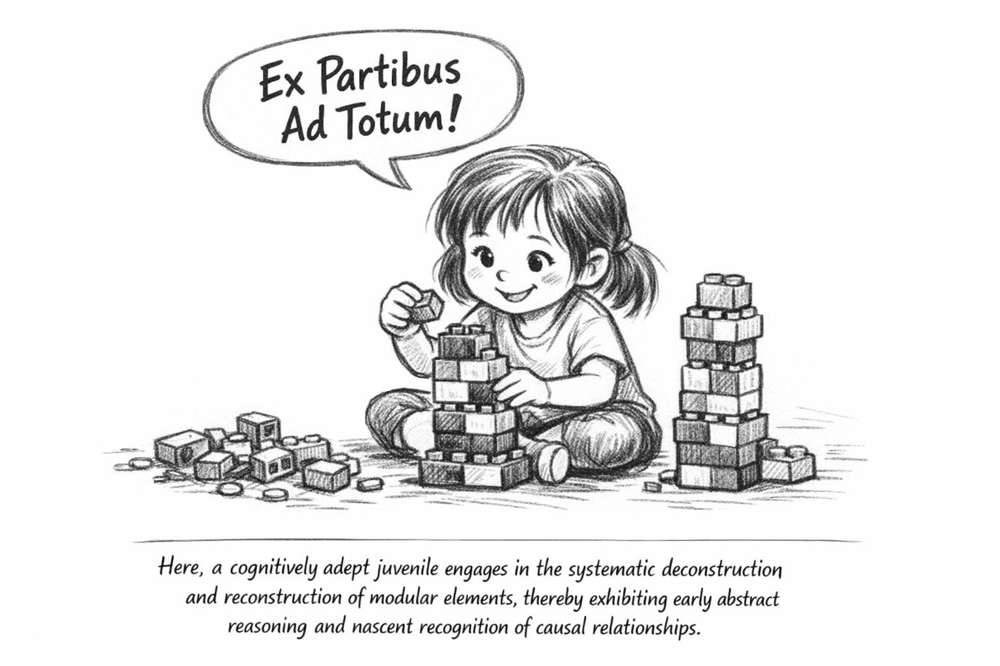
;-)
5

Slide 6
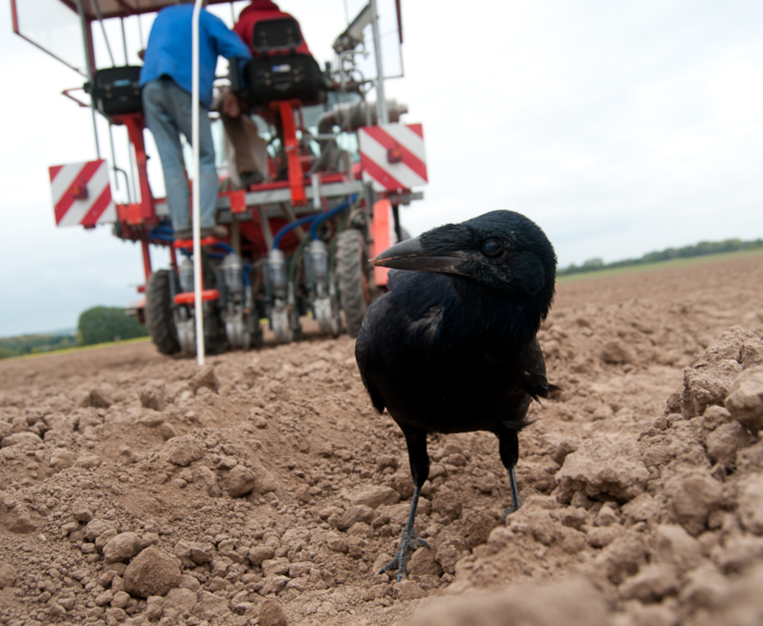
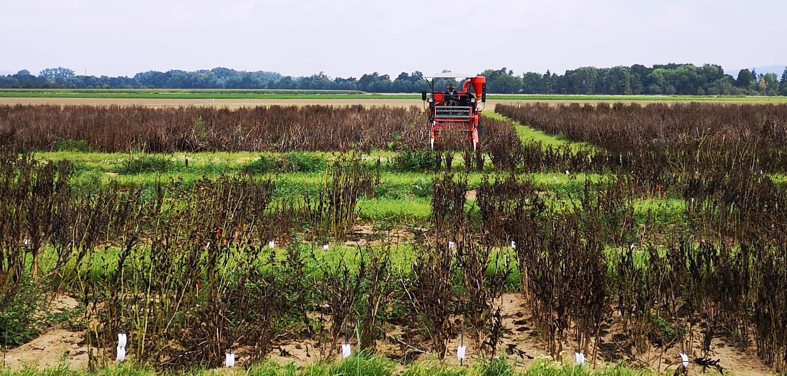
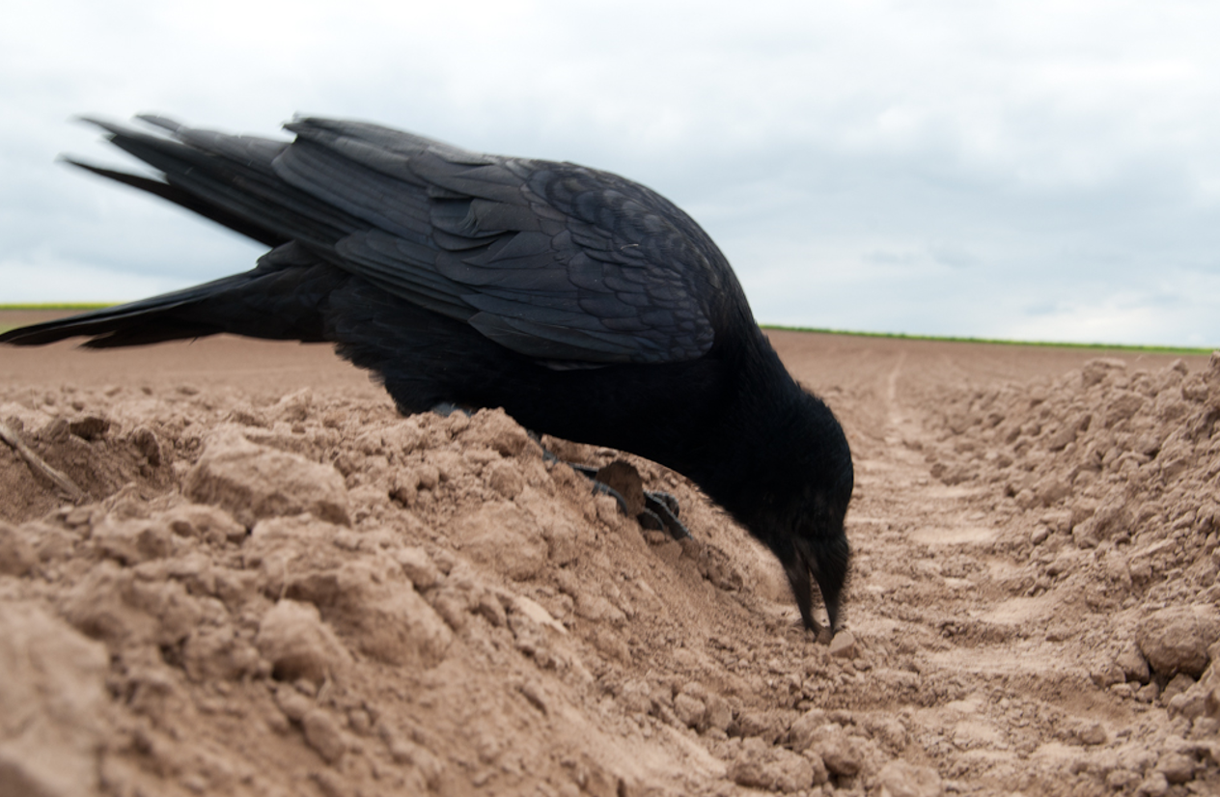
See UNPLAB chapters named ‘h²_GxE’; remember again what you studied in there. We proceed to the decomposition of the genetic and genotypic variance – this will ultimately lead to the decomposition of the genetic covariances among relatives ... هَللويَا
Sowing
Harvesting
© Gregor Welna
© Sonja Yaman
6

Slide 7
The distribution of the phenotypic values is modelled as distribution of sums-of-genetic- plus-masking effects.
An enlightening message: Given the ‚true‘ genetic value of a candidate, the probability of such candidate being ‚lifted‘ upwards to a phenotypic value or being ‚pushed‘ downwards to a phenotypic value is the same. This up or down is symmetrical.
Yet. Take as example the below-marked, superior phenotypic value. Assume we don’t know ’its’ true genetic value. The probability that this relatively high P value came from a lower G plus positive masking effect is higher* than the probability that is came from an even-higher G value plus a negative masking effect.
σ²_{G}
σ²_{M}
+
*Winners are rather doped than sick
σ²_{P}
=
7

Slide 8
We already modelled the phenotypic variance. Now we look deeper into the genetic part – and decompose it, and recompose it – algebraically-statistically, of course.
σ²_{P} = σ²_{G} + σ²_{M} = σ²_{G} + σ²_{G∙E} + σ²_{R(G∙E)}
σ²_{A}; α₁; α₁
A condition for breeding is ‘similarity between relatives’. And that kinship-based similarity can be modelled by … with what we are starting here. Let us discover and develop adequate tools. We want to increase the efficiency of breeding, in the interplay between selection unit, recombination unit, test unit (look again at these rôles of genotypes at
UNPLAB-BrMeth_Ch-5 until Ch-7).
σ²_{D}; δ₁₁;δ₁₂;δ₂₂
σ²_{M}= σ²_{G∙E} + σ²_{R(G∙E)}
σ²_{G}= σ²_{A} +σ²_{D}+σ²_{AA}+σ²_{XYZ}
σ²_{AA} (αα)₁₂
σ²_{XYZ}
8

Slide 9
We already modelled the phenotypic variance. Now we look deeper into the genetic part – and decompose it, and recompose it – algebraically-statistically, of course.
σ²_{P} = σ²_{G} + σ²_{M} = σ²_{G} + σ²_{G∙E} + σ²_{R(G∙E)}
σ²_{A}; α₁; α₁
Hopefully you've already noticed that σ²_{E} is not mentioned here! You know why. If each candidate is tested in its ‘private’ environment, then σ²_{E} must be included – then E effects impact the differences between the P values (some live in fertile environments, some in stressful ones). Such setting is mostly true in animal breeding and to some ex-tent in participatory plant breeding. Yet, we mostly avoid this. We grow all candidates together in the same environ-ment(s). Therefore, no one can rightly complain that they were in a stressful environment and others were not. Everyone was everywhere! So, E does not contribute to differences between candidates’ P values.
The equation here considers E=1 and r=1 (just for ease).
σ²_{D}; δ₁₁;δ₁₂;δ₂₂
σ²_{M}= σ²_{G∙E} + σ²_{R(G∙E)}
σ²_{G}= σ²_{A} +σ²_{D}+σ²_{AA}+σ²_{XYZ}
σ²_{AA} (αα)₁₂
σ²_{XYZ}
9

Slide 10
Decompose and recompose the Genetic variance (the Genotypic variance)
σ²_{P} = σ²_{G} + σ²_{M} = σ²_{G} + σ²_{G∙E} + σ²_{R(G∙E)}
σ²_{A}; α₁; α₁
We aim to decompose the genetic variance into
Additive variance,
Dominance variance,
Epistatic variance.
The difference between phenotypic variance and genetic
variance may be termed ‚masking‘ variance, σ²_{M}.
We understand: This is a simple model! A more detailed ‚explanation‘ needs further parameters, e.g. for variation caused by maternal effects, cytoplasmic effects, epigenetic differences; and may be more ... hence “σ²_{XYZ}” ;-)
We understand: Such model ‚works‘ with very specific model assumption (see later).
σ²_{D}; δ₁₁;δ₁₂;δ₂₂
σ²_{M}= σ²_{G∙E} + σ²_{R(G∙E)}
σ²_{G}= σ²_{A} +σ²_{D}+σ²_{AA}+σ²_{XYZ}
σ²_{AA} (αα)₁₂
σ²_{XYZ}
10

Slide 11
A comment on Genetic vs. Genotypic
σ²_{P} = σ²_{G} + σ²_{M} = σ²_{G} + σ²_{G∙E} + σ²_{R(G∙E)}
σ²_{A}; α₁; α₁
We have ‘Genetic Variance’ and ‘Genotypic Variance’.
Usually, Genetic variance is meant more ‚general‘;
to address the fraction of σ²_{P} which is ‚genetic‘.
Genotypic is specific: If the genetic variance is between genotypes; preferentially ‚repeatable‘ genotypes (tested in replicated trials) ... such as ‚genotypic variance‘ between clones, hybrids, lines. Even if the candidates are genetically not homogeneous, let's say the candidates are families; even then, the genetic part of the differences between such families could be called ‘genotypic’ variance.
Falconer, Mackay, Introduction to Quantitative Genetics 1996, Chapter 8.
DOI 10.1038/s41576-024-00711-3
σ²_{D}; δ₁₁;δ₁₂;δ₂₂
σ²_{M}= σ²_{G∙E} + σ²_{R(G∙E)}
σ²_{G}= σ²_{A} +σ²_{D}+σ²_{AA}+σ²_{XYZ}
σ²_{AA} (αα)₁₂
σ²_{XYZ}
11

Slide 12
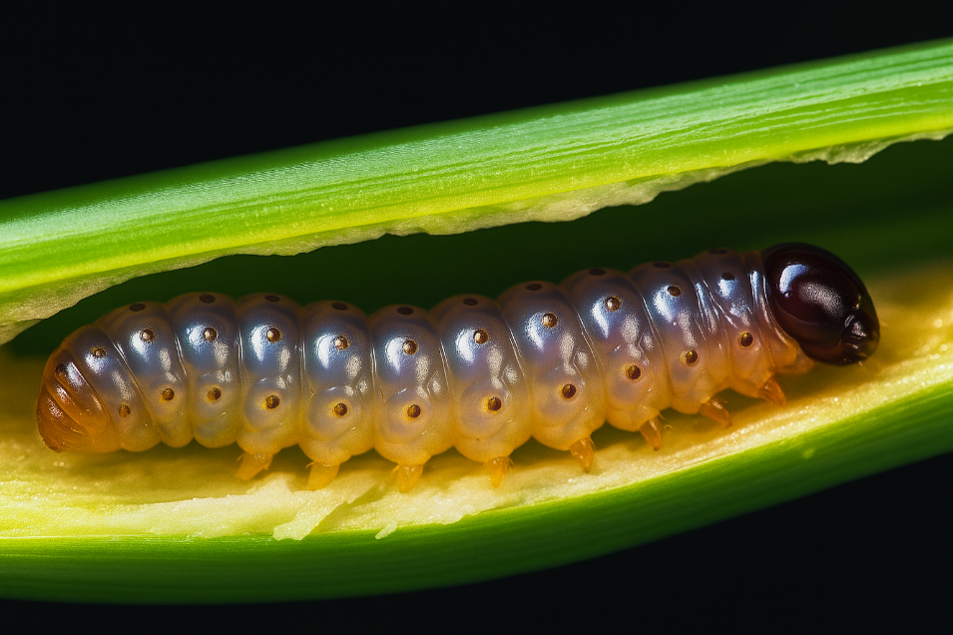
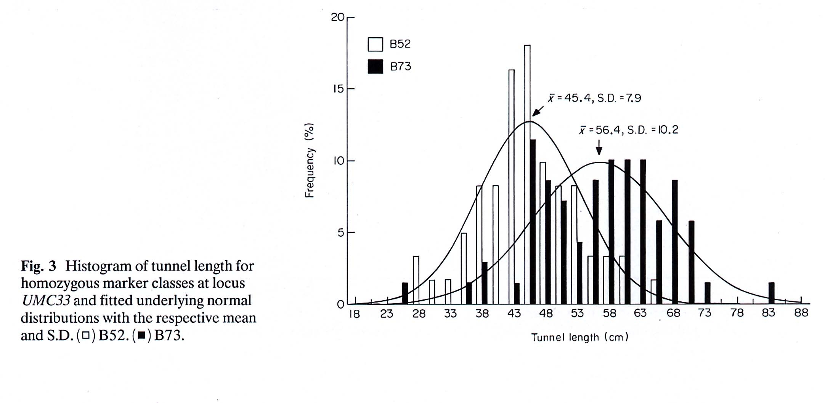
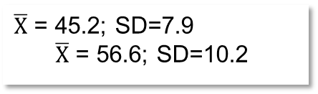
Schön, C.C., M. Lee, A.E. Melchinger, W.D. Guthrie, W.L. Woodman, 1993: Mapping and characterization of quantitative trait loci affecting resistance against second-generation European corn borer in maize with the aid of RFLPs. Heredity 70: 648-659.
12
$\overline{X}$ = 45.2; SD=7.9
$\overline{X}$ = 56.6; SD=10.2
Frequency %
Histogram of tunnel length for homozygous marker classes at RFLP locus UMC33 and fitted underlying normal distributions with the respect-tive mean value and value for the respective Standard Deviation
Tunnel length (cm)
Shorter tunnels mean higher resistance!

Slide 13
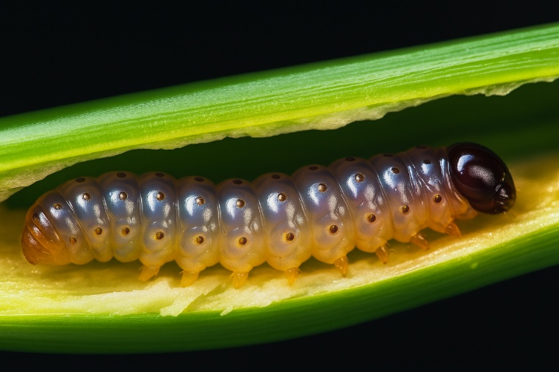
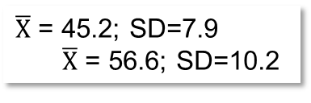
Schön, C.C., M. Lee, A.E. Melchinger, W.D. Guthrie, W.L. Woodman, 1993. Heredity 70: 648-659. We already used this data in UNPLAB-QuGen_Ch-4[MetrMod] page 11.
-a
+a
The white columns show the frequency of lengths for F3-lines derived from F2-individuals that were homozygous for the parent B52-derived DNA-marker allele.
The black ones … that were homozygous for the parent B73-derived DNA-marker allele.
Since the difference of 11.4cm was statistically significantly, the metric additive effect at a ‘marked’ QTL was estimated as a=5.7cm, half the difference between the homozygotes.
B52 x B73
F1
F2
F3
$\overline{X}$ = 45.2; SD=7.9
$\overline{X}$ = 56.6; SD=10.2
Frequency %
Histogram of tunnel length for homozygous marker classes at RFLP locus UMC33 and fitted underlying normal distri-butions with the respective mean value and value for the respective Standard Dev.
Tunnel length (cm)
Shorter tunnels mean higher resistance!
F3-lines from all marker-heterozygous F2s (not shown in diagram) were used to estimate d. Their tunnels were Ø1.1cm shorter than c=50.9 cm. From F2 to F3, heterozygosity is halfed: estimate of d = 2 ∙ (-1.1) = -2.2 cm.
13

Slide 14
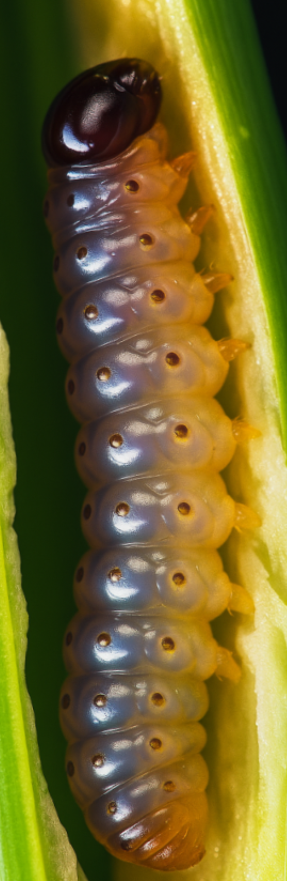
We search for the genetic variance between the genotypes. We assume HWE. Here, (p=q=0.5) this is like F2* (zero LD; no pair of QTL on same chromosome arm).
* 0.5² : 2∙0.5∙0.5 : 0.5² corresponds to 1 : 2 : 1; èchiaro, non è vero?
Focus on genetic variation of this trait, given genotypes are in HWE (again: 1:2:1=p²+2pq+q²).
Keep in mind, estimates of ‘a’ and ‘d’ were derived based on phenotypic data with h²<1 ;-)
The most resistant is homozygous for the favourable allele at 5 QTL plus heterozygous at QTL 5 and 7. In HWE, this one is rare, it occurs with (0.25)⁵∙(0.5)², this makes 1 : 4.096.
The least resistant type is homozygous for the susceptibility allele at all 7 QTL,
hence: (0.25)⁷ = 1 : 16.384.
Europ. corn borer (Ostrinia nubilalis; Maiszünsler); caterpillar (Raupe)
14

Slide 15
We make very much ado about the Genetic Variance, because this parameter is a crucial parameter which determines gain from selection. Immediate response to selection (Breeders’ Equation) is determined by
◘ Selection Intensity ◘ Heritability ◘ Genetic Variance.
We will use this simpli-fication to find the variance
between ...
the ●Breeding Values,
the ● Domi-
nance Devi-ations,
the ● Geno-typic Values
of our genotypes.
15

Slide 16
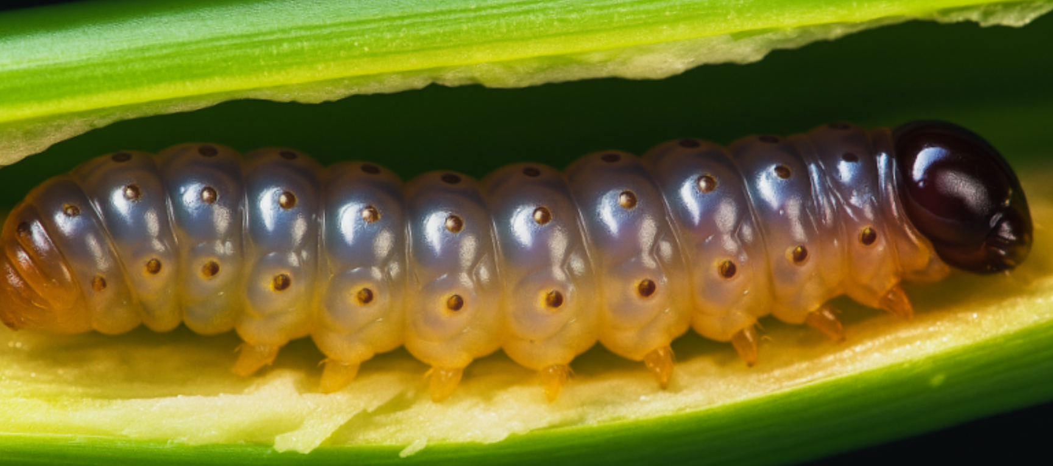
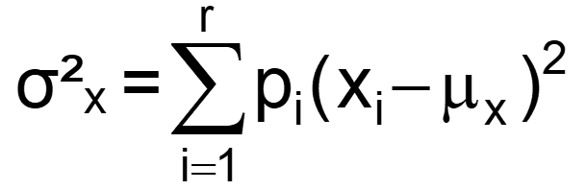
We search for the genetic variance between the genotypes in HWE (look at the genetic values of the F2-individuals; not at the genetic values of the F2-derived F3 lines).
Focus on the contribution of QTL2 ‘alone’ to the genetic variation at trait level.
HWE; p=q=0.5. So: p²=25% will have tunnels 5.7cm shorter and 25% 5.7cm longer than mean value c. And 2pq=50% heterozygotes will be 2.2cm shorter than mean value c.
We could select via DNA-marker of this QTL and make a step towards shorter tunnels.
What is the contribution of this locus to the population’s mean value (in our F2)?
We have c=50.9cm (shown earlier). µ = c + (p-q)a +2pqd = 50.9cm + 0.5 ∙ (-2.2) = 49.8cm
Indeed, with p=q, mean in HWE is ½∙d lower than c (here, d is negative; c-µ= ½∙d = 1.1cm)).
σ²_{QTL2(HWE)} = ¼(c+a -µ)² + ½((c+d -µ)² + ¼((c-a -µ)²
σ²_{QTL2(HWE)} = ¼(50.9+5.7-49.8)² + ½(50.9+(-2.2)-49.8)² + ¼( 50.9-5.7-49.8)² = 17.455cm²
This is the contribution of QTL2 to the genotypic variance in HWE (HWE here ≙ F2).
Which part of this genotypic variance is due to additive effects?
Europ. corn borer (Ostrinia nubilalis; Maiszünsler); caterpillar (Raupe)
16

Slide 17
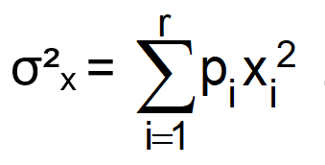
We search for the genetic variance between the genotypes.
‘Which part of this genotypic variance is due to additive effects?’
If the populations was homozygous, ... ‘stop, hold on a second’
... if we e.g. had ‘all’ possible DH-individuals of the HWG population or, rather, a very large, fully representative sample of ‘all’. If we had the homozygous version of the population without change of allele frequency! There-then, if the populations was homozygous, at F=1 and with P(A1A1)=p(A1) and with Q(A2A2)=q(A2) and H(A1A2)=0 (no heterozygotes):
Then ... all variance then is ‘additive’.
There-then, indeed 50% of the population members are ‘c+a’ ; 50% are ‘c-a)’.
Population mean µ* then is µ=pa-qa, with p=q; µ=0, hence►►
σ²_{QTL2(F=1)} = ½ (+5.7)² + ½ (-5.7)² = 32.49cm²
Europ. corn borer (Ostrinia nubilalis; Maiszünsler); caterpillar (Raupe)
*not the mean tunnel length; but (sondern) the mean impact of QTL2 on tunnel length.
17

Slide 18
We search for the genetic variance between the genotypes. Is it HWE or is it F=1?
σ²_{QTL2(F=1)} = ½ (+5.7)² + ½ (-5.7)² = 32.49cm²
Well: 32.49cm² is the genetic variance due to this QTL between the members
of that population in case the population was at F=1 (no other genetic change, just inbred, all else same, of course).
To compare: σ²_{QTL2(HWE)} = 17.455cm² (genotypic variance at HWE)
Is σ²_{QTL2(F=1)} = 32.49cm² a meaningful ‚additive‘ variance:?
It is the genetic variance at homozygosity. It is not exactly what we here-search.
Because: Strictly speaking, we are looking for the additive part of the genetic variance at Hardy-Weinberg equilibrium - but we have in this moment been looking at something else: the genetic variance at F=1.What we actually want is the Variance among the members of the HWE population for their Breeding Values, A. Let’s dive a ‘tiny bit’ into Algebra.
For Nerds only: 2∙17.455=32.491
The genetic variance among the homozygotes is double the additive variance at HWE – if d=0 or if p=q=0.5 (if both then as well).
Europ. corn borer (Ostrinia nubilalis; Maiszünsler); caterpillar (Raupe)
18

Slide 19
We are actually searching for the additive part of the genetic variance
at Hardy-Weinberg-Equilibrium.
Although, if the entire population is homozygous (without loss nor gain of alleles - no Selection no Mutation no Migration; F=1 for everybody in the population), although then, okay, then the metric dominance d is not realized and all is additive (a), so although this indeed is true, nevertheless, this is not the additive scenario that we want to study (that I want to explain to you).
What I am really out of here is the variance between the members-of-the HWE population for their Breeding Values A aka for their A values aka for their ‘Breeding Values’. We dive a ‘tiny bit’ into Algebra.
19

Slide 20
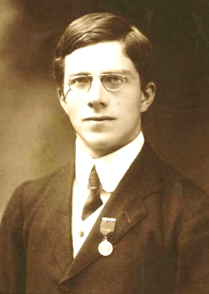
To algebraically deduce the variance between the Breeding Values, we first invest to realize that – in a HWE setting – the pertinent means are zero.
Sir Ronald Fisher (1890-1962); he invented / found this Algebra
https://de.wikipedia.org/wiki/Ronald_Aylmer_Fisher; https://www.adelaide.edu.au
20

Slide 21
To algebraically deduce the variance between the Breeding Values, we first invest to realize that – in a HWE setting – the pertinent means are zero.
α₁ – α₂ = [a-(p-q)d] = [α]
α = „average effect of a gene substitution“
(Durchschnitts-Effekt einer Gensubstitution);
the effect on offspring when substituting the focal allele A1 with A2.
It is, indeed, α₁ minus α₂.
Inspect the mean of the population for the additive effect’s column.
µ_{(BV)} = p² ∙ 2q α + 2pq ∙ (q-p) α – q² ∙ 2p α = 2p²q α + 2pq² α - 2p²q α - 2pq² α = 0. The mean is zero.
Of course: On average, the genotypes of the population, as parents, neither improve nor deteriorate the population.
On average, taken the entire population, its breeding value ‘for itself’ is zero.
Sir Ronald Fisher (1890-1962)
He invented / found this Algebra
21

Slide 22
To algebraically deduce the variance between the Breeding Values, we first invest to realize that – in a HWE setting – the pertinent means are zero.
α₁ – α₂ = [a-(p-q)d] = [α]
α = „average effect of a gene substitution“
(Durchschnitts-Effekt einer Gensubstitution);
the effect on offspring when substituting the focal allele A1 with A2.
It is, indeed, α₁ minus α₂.
Inspect the mean of the population for the additive effect’s column.
µ_{(BV)} = p² ∙ 2q α + 2pq ∙ (q-p) α – q² ∙ 2p α = 2p²q α + 2pq² α - 2p²q α - 2q²2p α = 0. The mean is zero.
Of course: On average, the genotypes of the population, as parents, neither improve nor deteriorate the population.
You find out for yourself: The mean of the population for its dominance deviations is zero, too. For this, do not forget to again employ the HWE frequencies of the genotypes ;-)
What is the actual tactical value of this endeavour? Since, for the additive as well as for the
dominance effects, the mean of the population is zero, therefore the Algebra for the variance of
these effects becomes simple. That is the reason for this uprising here.
22

Slide 23
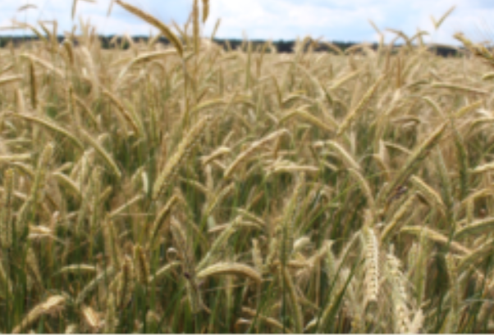
23
Nearly there 🎶 at the variance due to differences in Breeding Values, σ²_{A}
© A K Rada 2016
Given HWE: r=0
The probability that parent 1 actually contributed allele A1 (along with its impact on phenotype) is p; and for allele A2 it is q, irrespec-tive of the other parent‘s contribution (A1 or A2). See example in the table here with p=0.75. Note that in case of HWE parent 1 and parent 2 alleles are uncorrelated. If the population is at F=1, then it came from selfing of homozygous parents, then the correlation between alleles that came via female and male gamete is r=1.

Slide 24
Breeding Values’ variance: Realize that in HWE, pertinent correlations are zero.
If you like, think of the 32 „parents 1“ as the 32 mothers of the symbolized (‚random-mated‘) genotypes (individuals) here.
Note that the 32 individuals are in perfect HWE for the focal locus (p=0.75).
The allele inherited by parent 1 is in p=75% of the cases A1 and in q=25% of the cases A2.
With HWE frequencies of genotypes, the contributions of the parent 1-inherited allele to σ²_{A} are zero-correlated with the contribution of the parent-2 inherited allele. They simply add up to σ²_{A} of the HWE genotypes as σ²_{A} = σ²_{α'} + σ²_{α''}.
The parent 1-contributed allele A₁ occurs in A1A1 genotypes with probability p², and in A1A2 genotypes with pq. Note: p² + pq = p. As stated above, p is the general probability for a genotype of receiving from parent 1 allele the allele A1. Anyway, it contributes α₁.
Probability ► p Effect ► α₁
And q is the probability of receiving the parent 1 allele as A2. In these cases its A2A1 heterozygotes occur with frequency pq; the A2A2 homozygotes are rare (q²).
Now, parent 1 contributed along with A2 its average effect of α₂.
Probability ► q Effect ► α₂
24

Slide 25
We patiently found:
Means are zero,
so Algebra to calculate variances is simplified.
Correlations are zero,
so Algebra to sum up variances is simplified (see below).
25

Slide 26
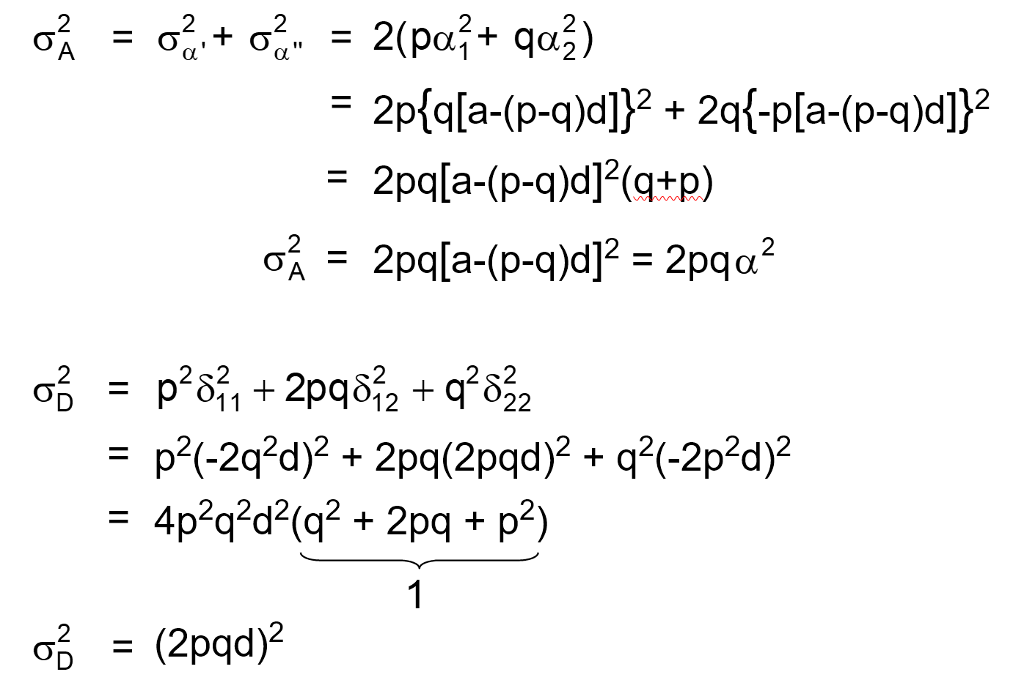
The variance of Breeding Values, σ²_{A} (for ‘they simply add up’ ... see a bit later)
Probability ► p Effect ► α₁
Probability ► q Effect ► α₂
See (left) the parent 1 contributed allele-effect written as α‘ (α‘ =p α₁ +q α₂). The additive variance, caused by the parent 1 contributed allele, is
σ²_{α'} =p (α₁)² + q (α₂)²
For symmetry reasons, σ²_{α'} = σ²_{α''}
σ²_{A} = σ²_{α'} + σ²_{α''}
Again: With HWE frequencies of genotypes, the contributions of the parent 1 inherited allele to σ²_{A} are uncorrelated from the contribution of the parent-2 inherited allele; therefore, they simply add up to σ²_{A} of the HWE genotypes
(σ²_{A} = σ²_{α'} + σ²_{α'}).
σ²_{A} = σ²_{α'}+σ²_{α''} = 2∙σ²_{α'} = 2∙σ²_{α‘‘} = 2[p(α₁)² + q(α₂)²] = 2pq α² = 2pq [a – (p-q)d]² = σ²_{A}
Memento: α=α₁-α₂
26

Slide 27
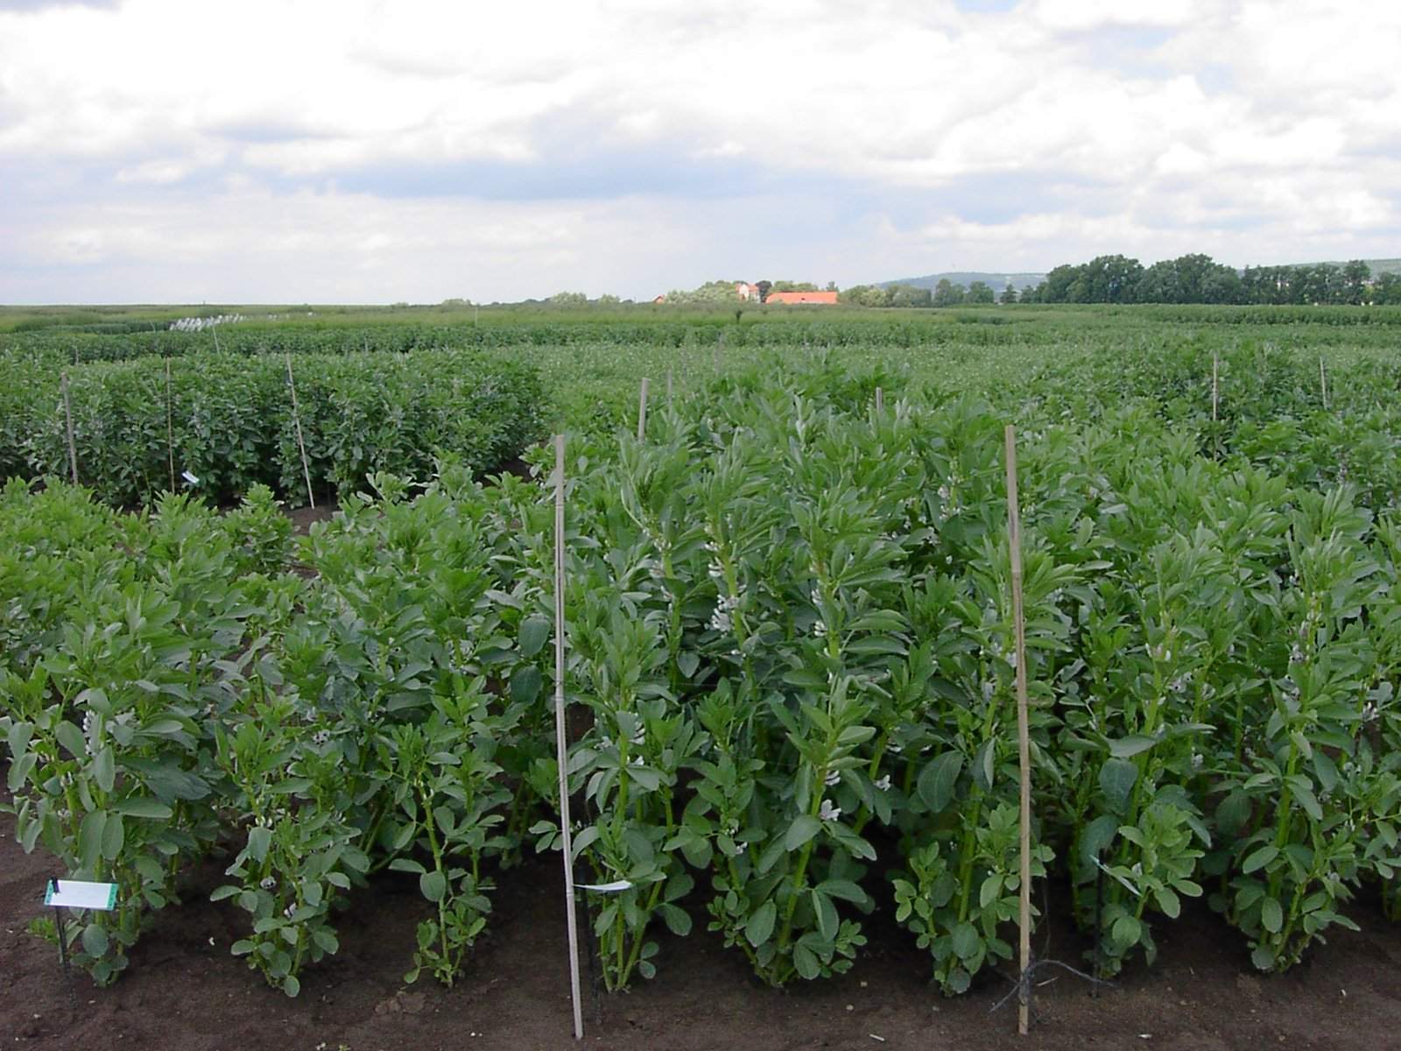
Enjoy a moment of recovery and recreation … before we continue.
This was, I think, anyway the only instance where I really ‚deduce‘ the Algebra that we use.
Normally, I just present the equations as give-away ;-)
27

Slide 28
Variance of Breeding Values, i.e.
Additive Variance:
σ²_{A} = 2pq[a-(p-q)d]²
= 2pq α²
In case you just accept this equation and skip or postpone its derivation (given in the last few pages here), that is no problem at all. As said, I will anyway refrain from really deriving-deducing the further (bit of) Algebra that is needed for Quantitative Genetics ;-) and Applied Genetics in Plant Breeding.
28

Slide 29
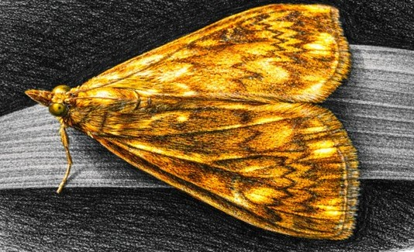
Apply the new equation for Additive Variance
σ²_{QTL2(HWE)} = ¼(c+a -µ)² + ½((c+d -µ)² + ¼((c-a -µ)²
σ²_{QTL2(HWE)} = ¼(50.9+5.7-49.8)²+½(50.9+(-2.2)-49.8)²+¼( 50.9-5.7-49.8)²=17.455cm²
Genetic variance ‚caused‘ by QTL2 in HWE (zero-inbreeding).
σ²_{QTL2(F=1)} = ½ (+5.7)² + ½ (-5.7)² = 32.49cm²
Genetic variance ‚caused‘ by QTL2 if we are at F=1 (all-is-homozygous).
σ²_{A} = 2pq [a – (p-q)d]² = σ²_{A}
σ²_{A} = 2(0.5)(0.5)[5.7-(0.5-0.5)(-2.2)]² = 16.245cm²
Additive genetic variance; Variance of the Breeding Values A (Population in HWE)
16.245cm² is less than the genetic variance of 17.455cm² (in 16.245, Dominance Variance is not included); … and it is much less than genetic variance at homozygosity of 32.49 cm².
It is half-of-that, very probably not just by chance ;-) that is perfectly fine, we'll get to it later.
Europ. corn borer (Ostrinia nubilalis; Maiszünsler); above caterpillar (Raupe); below Imago with artis-tic flair, see the metallic sheen)
29

Slide 30
Apply equation for Additive Variance and equation for Dominance Variance
σ²_{QTL2(HWE)} = ¼(50.9+5.7-49.8)²+½(50.9+(-2.2)-49.8)²+¼( 50.9-5.7-49.8)²=17.455cm²
σ²_{A} = 2pq [a – (p-q)d]² = σ²_{A}
σ²_{A} = 2(0.5)(0.5)[5.7-(0.5-0.5)(-2.2)]² = 16.245cm²
Additive genetic variance; Variance of the Breeding Values A (Population in HWE)
Equation for Dominance Variance: 😲 Dominance Variance σ²_{D} = (2pq d)².
The genetic contributions of the dominance deviations δ₁₁ , δ₁₂ , δ₂₂ to the genetic variance.
Apply it to the parameters of QTL2.
σ²_{D} = (2pqd)² = [2(0.5)(0.5)(-2.2)]² = 1.21cm²
σ²_{G} = σ²_{A} + σ²_{D} = 16.245cm² + 1.21cm² = 17.455cm²
Nice! The sum, σ²_{G}, is the same as we had calculated brute-force earlier (page 16).
Dominance Variance σ²_{D} = (2pq d)².
Europ. corn borer (Ostrinia nubilalis; Maiszünsler); caterpillar (Raupe)
30

Slide 31

On the next two pages we celebrate the same thing (correlation zero ...) again.
Either you join the party or you skip it. Either choice is fine.
31

Slide 32
Cheers to orthogonality of parameters (example with p=3/4; a=1; d=2/3)
Can we indeed ‚simply‘ write:
σ²_{G} = σ²_{A} + σ²_{D} ?

Slide 33
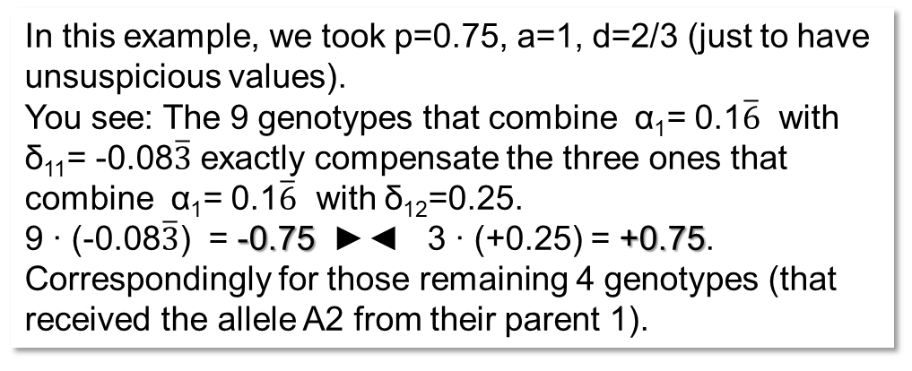
Cheers and hurray to the orthogonality of parameters
In this example, we took p=0.75, a=1, d=2/3 (just to have unsuspicious values).
You see: The 9 genotypes that combine α₁= 0.1$\overline{6}$ with δ₁₁= -0.08$\overline{3}$ exactly compensate the three ones that combine α₁= 0.1$\overline{6}$ with δ₁₂=0.25.
9 ∙ (-0.08$\overline{3}$) = -0.75 ►◄ 3 ∙ (+0.25) = +0.75.
Correspondingly for those remaining 4 genotypes (that received the allele A2 from their parent 1).
Not only are α₁ and α₂ uncorrelated, both are uncorre-lated to the deltas. Hence, when adding the variances caused by α₁ and α₂, we have not to consider covariance. When writing σ²_{G} = σ²_{A} + σ²_{D} (+ 2 cov_{AD)}), we have no covariance to consider. How extremely friendly!
Of course: This polite orthogonality and un-correlatedness can be proven via honest Algebra. Go for it!
And, of course: If you abandon HWE, it does not hold any more!
This is quite unusual. Usually:
σ²_{(x+y)} = σ²_{(x)} + σ²_{(y)} + 2∙cov_{(xy)}

Slide 34
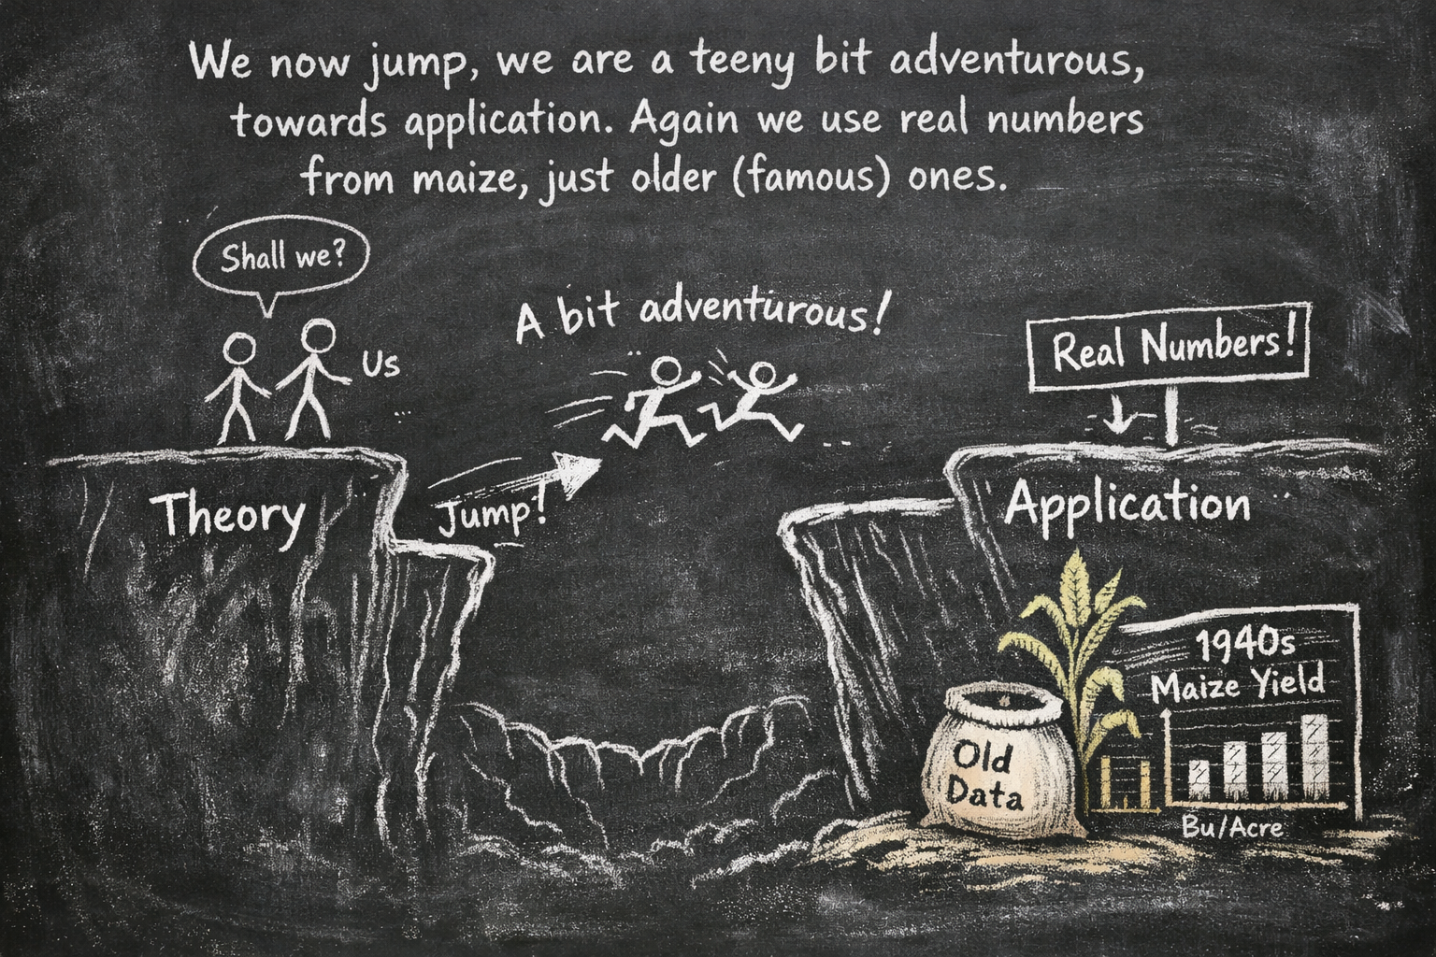
From here you may go to UNPLAB-QuGen_Ch-9[Decomp-GenV II]
34

